Slide 1
Liz Henry University of Sunderland
Dr Stephanie Wilkie, Dr Diane Stevens, Dr Diane Westwood
‘They said I shouldn’t walk alone’: Perceived barriers and facilitators to accessing enhancing places

Slide 2
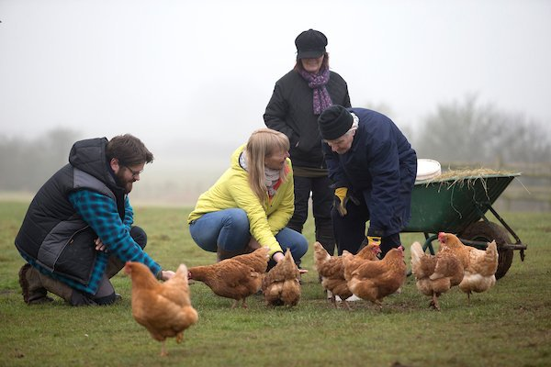
Context
Environmental Psychology research has explored the idea that places can have a positive impact on well-being.
Often natural places.
This has been applied in a structured way through interventions and policy. e.g. social prescribing, care farms, green gyms, forest schools.

Slide 3
Aim
How do physical environments enhance and maintain positive well-being outcomes in individuals?
Aim of Today’s Presentation is to :
Explore perceived barriers and facilitators to place access
Integrate these with the COM-B model for behaviour change
Provide suggestions for increasing the use of places to enhance well-being
Notes:
Opportunities to understand sources of well-being are important – Environmental Psychology has always sought to better understand the impact we have on environments but also the impact our environments have on us. The aim of this research was to explore the potential for places to enhance or maintain our well-being

Slide 4
COM-B model of behaviour
Factors that contribute to Behaviour (Michie et al. 2011)
Capability
Opportunity
Motivation
The model targets individual behaviour but can also be applied within a wider socio-cultural and political level of influence.
Applicability - Behaviour Change Wheel was developed to tie the COM B model with behaviour change strategies and interventions and policy.
Notes:
The advantage of positioning the findings within theoretical frameworks is that we can compare research more readily but also can lead to considering how we can change behaviour in a way that could lead to improved well-being - Michie et al (2011) developed the behaviour change wheel that helps to consider how difference behaviour change strategies tie in with the COM B model. It was developed in part to clarify the differences between policy and intervention and keep the focus on context. The barriers and facilitators an individual has can be mapped onto the COM B model and then provide an indication of interventions that are more likely to be appropriate. So if we want to embrace notions of ‘social prescribing’ (e.g. care farming, green gyms) highlighted in the 2018 green future plan we need to optimise the suitability and effectiveness of interventions that have at their heart people-place relations.

Slide 5
Capability
COM B model of behaviour
Motivation
Behaviour
(Accessing enhancing places)
Opportunity
Michie et al. (2011)
Notes:
The barriers and facilitators a person reports when asked to reflect on enhancing places may impact on them spending time in these places and this may impact on opportunities for improved well-being. This behaviour can be interpreted in terms of the COM B components. We may be able to identify which components are most pertinent for a specific individual. This may help us understand better factors impacting on health behaviour (in this example use of enhancing places).
Capability –capacity to engage, including knowledge and skills
Motivation – processes that energize and direct behaviour including innate disposition and conditioning
Opportunity – factors outside the individual that make behaviour possible - this is the context

Slide 6
Procedure
Semi-structured interviews (30-60 minutes)
Twenty participants aged 25+
Opportunity sample recruited via three regional organisations:
Sixth form college
University
U3A group
Inductive Thematic Analysis (ITA)
Notes:
This is a qualitative study on a small sample, the aim of the research is to offer a rich interpretation of people perceptions of spending time in places they felt in some way maintained or enhanced their well-being. Gender of sample 12 women, 8 men, aged 25-44 n=7, 45-64 n=5, 65+ n=8
ITA codes the data to identify themes and subthemes

Slide 7
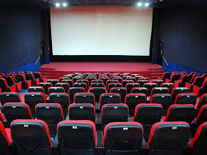
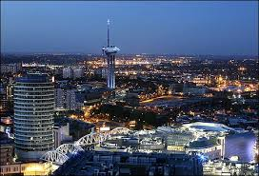
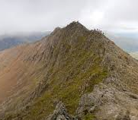
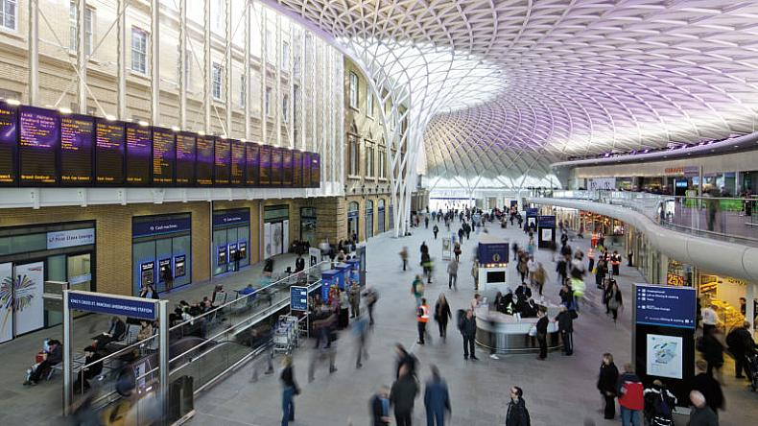
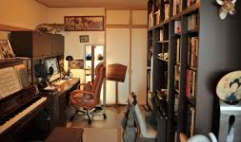
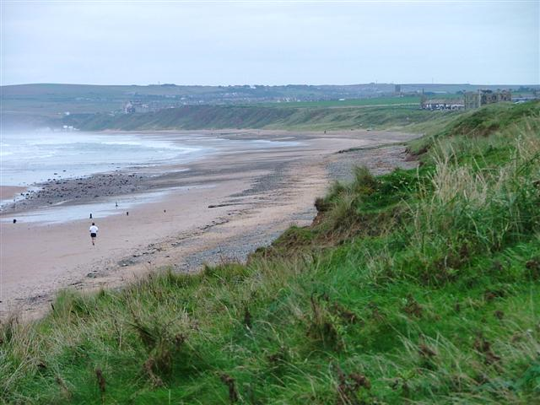
Places identified as enhancing well-being
Notes:
A very broad range of places (especially given the small sample) well beyond the ‘traditional’ green/UGS/Urban TOP categories. Focus in recent years is the positive impact of ‘natural’ spaces for example the recent government ‘A green future’ 25yr environment plan states that “Spending time in the natural environment – as a resident or a visitor – improves our mental health and feelings of wellbeing”
“Connecting more people with the environment will promote greater well-being. “ Theresa May 2018
but clear even from this small scale study that if our aim is to look at ways to maintain or improve well-being we need to keep an open mind as to the places people perceive as enhancing.

Slide 8
Potential facilitators
Physical Access
Social Factors
Cognitive Factors
Convenience
Route finding
Group membership
Social acceptance
Memories
Goal setting
It’s somewhere you can go there and back in a day“
So it’s no judgement and you’re accepted for who you are
I spent a lot of time as a child outdoors and so I can only assume that it builds from there
Notes:
By facilitators I mean factors individuals thought of as in some way allowing or supporting their access to places they felt maintained or improved their well-being.
Overall there were fewer examples of explicit facilitators mentioned.
In many cases these were just the absence of the barriers (e.g. time or skills). Some factors can be considered as continuums ( e.g. fitness, confidence)
In this case 3 main themes were identified – EXAMPLES of subthemes are provided with supporting data extract.

Slide 9
Potential barriers
Physical Access
Perceived Ability
Perceived
Risk
Social Factors
Distance
Route finding
Poor health
Lack of confidence
Personal safety
Vulnerability
Family responsibility Social expectations
The path will become perhaps either overgrown or ploughed up
The further away I am from somewhere familiar and the more nervous I’m going to get
I realise I’m more vulnerable physically because I’m 70
They said I shouldn’t walk alone and I said well why ever not? I’ve always walked on my own. I mean who is going to hang around the moors waiting for me?
Notes:
By barriers I mean factors individuals thought of (real or imagined) as in some way preventing or limiting their access to places they felt maintained or improved their well-being.
Through the Inductive process 4 main themes were created that I felt best reflected the data corpus

Slide 10
COM B model of behaviour
Physical
Capability
Physical access
Route Finding
Psychological
Perceived ability
Effects of aging
Reflective process
Motivation
Behaviour
(Accessing enhancing places)
Automatic
Physical Environment
Opportunity
Social Factors
Group Membership
Social Environment
Notes:
The barriers and facilitators a person reports may impact on them spending time in these places and this may impact on opportunities for improved well-being. This behaviour can be interpreted in terms of the COM B components. We may be able to identify which components are most pertinent for a specific individual. This may help us understand better factors impacting on health behaviour (in this example use of enhancing places).
Capability –capacity to engage, including knowledge and skills
Motivation – processes that energize and direct behaviour including innate disposition and conditioning
Opportunity – factors outside the individual that make behaviour possible - this is the context
Route finding –coded within the theme of ‘physical access’ – mapped onto Psychological capabilities C (knowledge, memory and skills)
Effect of aging – coded theme ‘Perceived ability’ – mapped onto Reflective process M (belief about capabilities, optimism/pessimism)
Group membership – coded within ‘Social Factors’ – mapped onto Social environment O (social influence, social support, group id)

Slide 11
Being able to be physical, which is a problem as you get older because it’s very hard to go on being that physical as you were and I don’t think I’ve come to terms with that yet.
‘J’, Female, 75+, U3A member, gardener, Segway rider, traveller.
This extract was coded under the ‘Perceived ability’ theme, within the subtheme ‘effect of aging’.
Notes:
desired outcome and targeted behaviour goals. We want ‘J’ to have improved well-being outcome and overcome the barrier to spend more time in her chosen place
This barrier fits in with the Motivation component (Reflective process) of the COM B model (reflective) . J’s concerns about her physical abilities changing with age effect her capacity to engage with her garden,
The behaviour change wheel links this component of the COM B to as they are likely to be appropriate forms of intervention

Slide 12
We have a clear idea of desired outcome and targeted behaviour goals. We want ‘J’ to have improved well-being outcome and overcome the barrier to spend more time in her chosen place
This barrier fits in with the Motivation component of the COM B model. J’s concerns about her physical abilities changing with age effect her beliefs about her capacity to engage with her garden
The behaviour change wheel links this component of the COM B to training or coercion as they are likely to be appropriate forms of intervention
Notes:
Coercion – increased expectation of punishment or cost -
Training – imparting skills

Slide 13
Key Take Away Messages
Understanding potential barriers and facilitators could support:
Individuals: Develop programmes that address multiple aspects of behaviour change
Intervention functions: The effective development and use of strategies and interventions aligned with ideas of therapeutic places and social prescribing (e.g. allotment schemes, care farms, health walks, green gyms)
Policy: Enabling or supporting appropriate interventions
Elizabeth.Henry@research.sunderland.ac.uk e.j.henry@outlook.com @ejhenry3

